Slide 1
React Hooks – useState, useEffects, Custom

Slide 2
What are React Hooks?
There are two types of components in react.
Functional components also known as Stateless component, container component
Class-based components also known as Stateful component

Slide 3
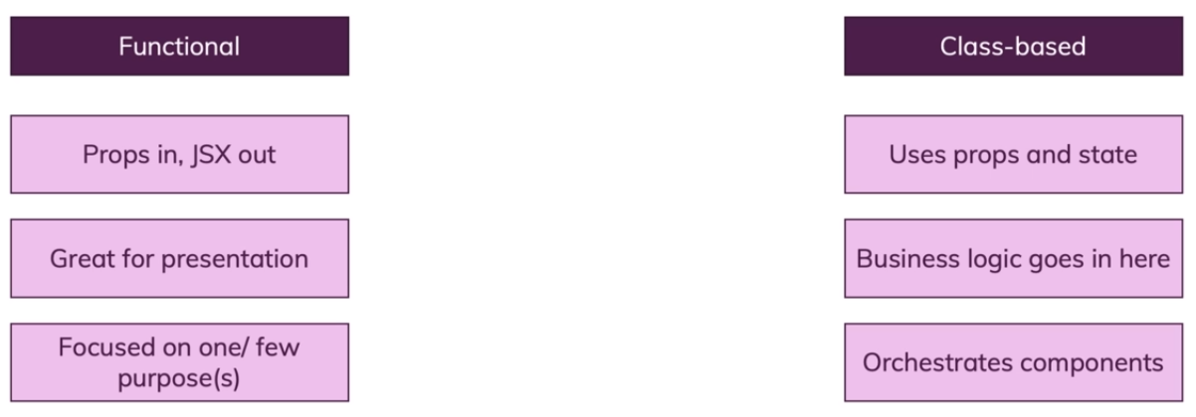
What are React Hooks?

Slide 4
Now with all been at the point where we had a functional component and all of a sudden we needed to manage some state in there.
For example you have inputs there and you want to store input the user entered in your state and send it back into the input. It is classic two way binding thing.

Slide 5
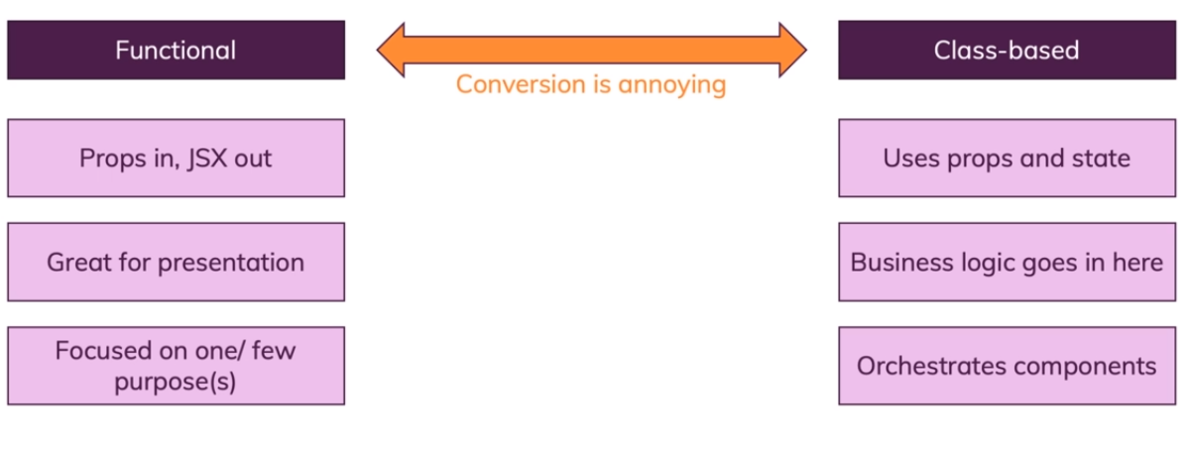
Now in such a case you would have to convert your functional component to a class based one but of this conversion is annoying it's a lot of redundant work in the end.

Slide 6
Now in addition to managing state class based components all were the only components that could have lifecycle methods also called lifecycle hooks which are not to be confused with reactive hooks.

Slide 7
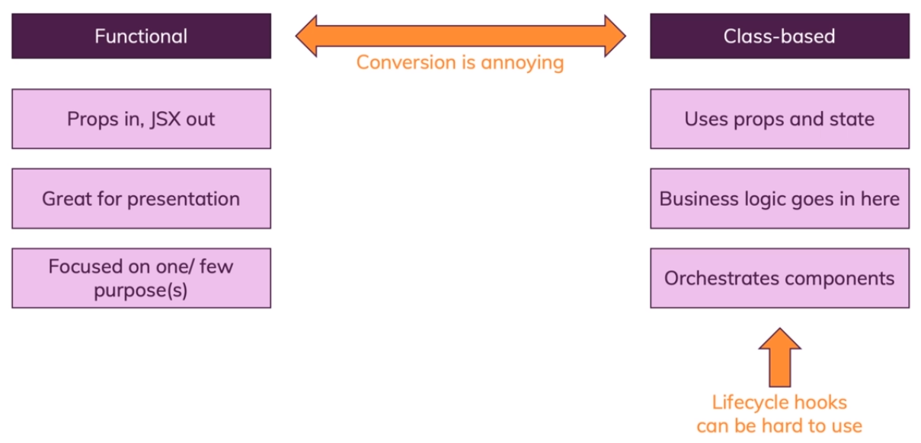
Now these lifecycle hooks or lifecycle methods also could be hard to use. It could be annoying to add component that mount component it update and ensure that you run the right logic at the right point of time and maybe add the right if checks to a wide unnecessary reminders or infinite loops.

Slide 8
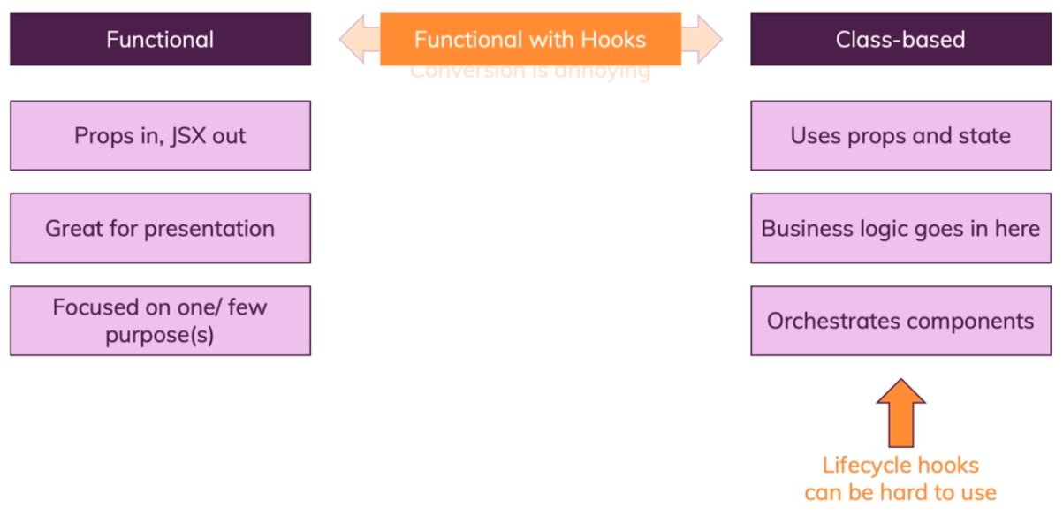
For these reasons, for example to get rid of the conversion we have react hooks. Because react hooks essentially allow us to work with functional components only.

Slide 9
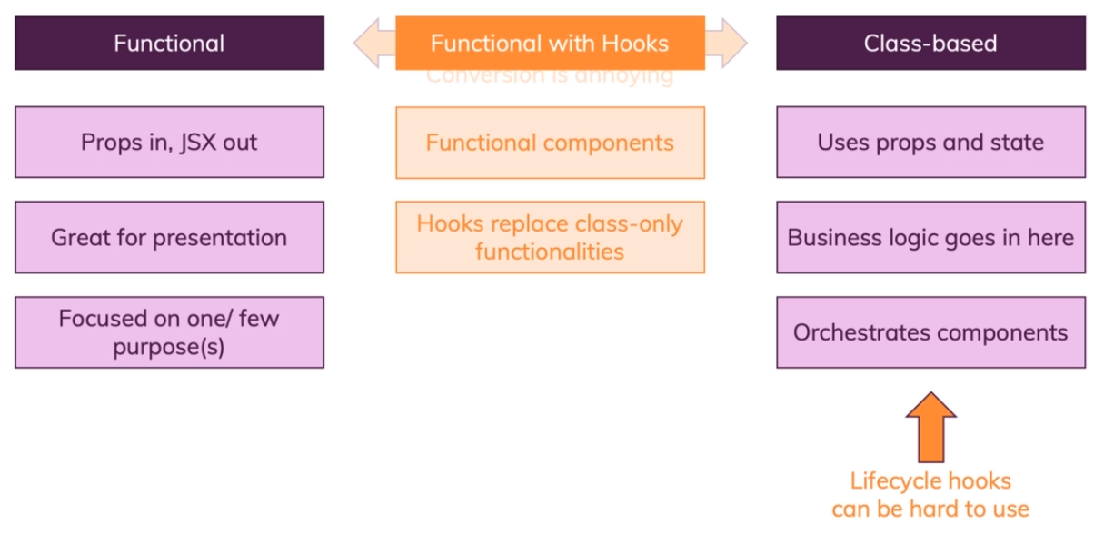

Slide 10
When working with this new feature you don't need to build any more class based components. You still can, but you don't have to.
You can now make everything work in functional components that previously required a class based component.
So you can write functional components everywhere and hooks replace class only functionalities.
They replace state management and they replace lifecycle hooks

Slide 11
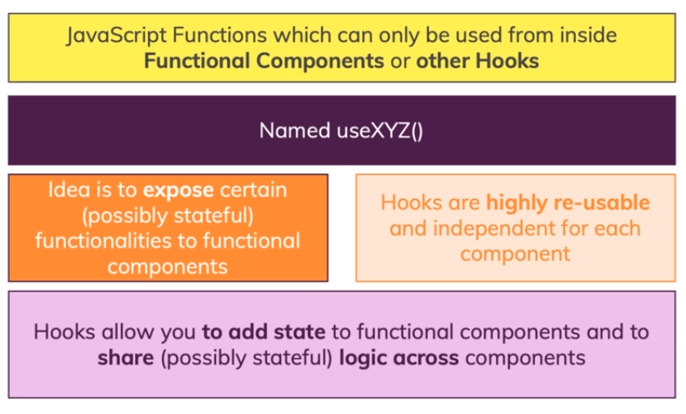
What are React Hooks?

Slide 12
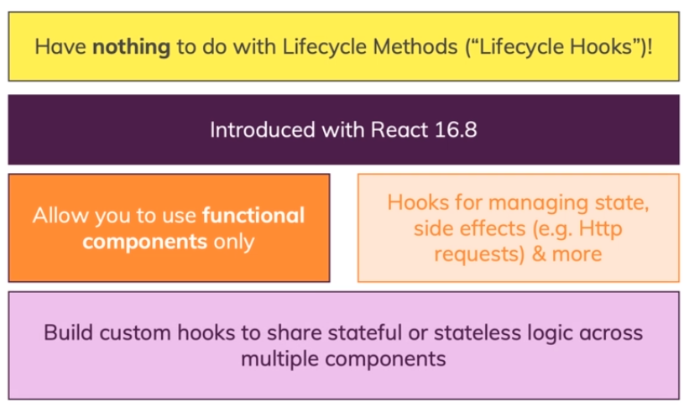
What are React Hooks?

Slide 13
https://github.com/academind/react-hooks-introduction
Extract the start files.
Open it in the editor.
Run npm install
Run npm start
The application is simple. It displays the list and details of Star Wars characters. It has two modes. Light mode and Dark mode. When you switch to dark mode, you can go full to destroy the character.

Slide 14
In this application, we have class-based components in all the places where we need to manage state or have life-cycle hooks.
However, the Summary component is a functional component because it is purely presentational component that outputs information and does not manage any state.
That is the old world.

Slide 15
In the new world with React hooks, you still have presentational components and it’s still a good idea to not manage state in every single component just because you can.
It’s still good to have as many presentational components as possible and manage state in a few selected container components.
That does not change just because now you can use functional components only.

Slide 16
However, what does change is that you don’t have to use ‘class’ and create components in different way just because you want to use state.
Let us see that in the App component.

Slide 17
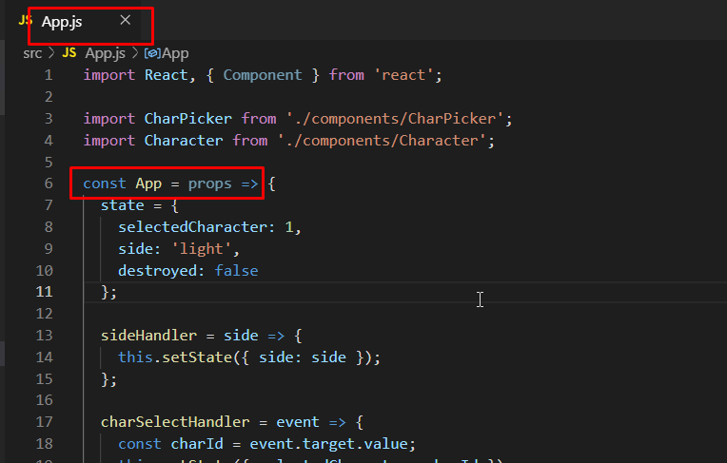
We can create this as a functional component now.

Slide 18
Then just to have our function body which in the needs to return some jsx.
That is what a function needs to do to qualify as a functional component in react.

Slide 19
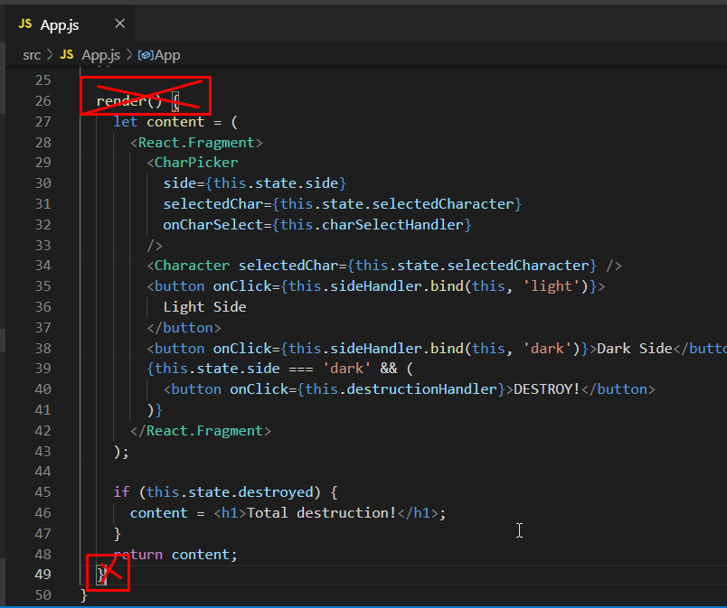
We do have a render method here which we need to remove. Now we have the content which we return in the end. We now have a function that returns jsx and hence it is a perfect functional react component.

Slide 20
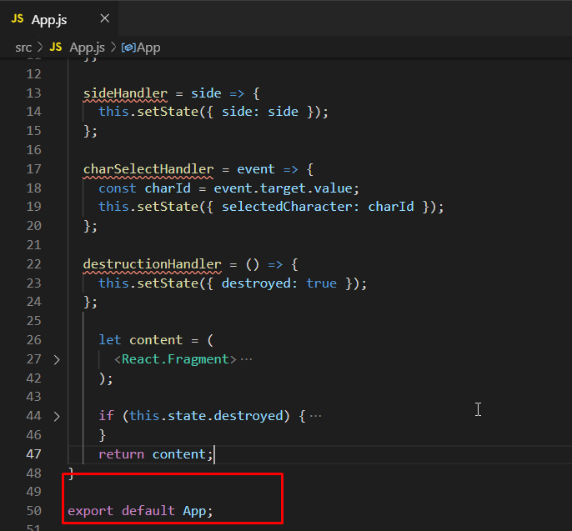
We are exporting it here already but it has state above and the problem is that it doesn’t work anymore.

Slide 21
From React 16.8, you can use the special method called useState.

Slide 22
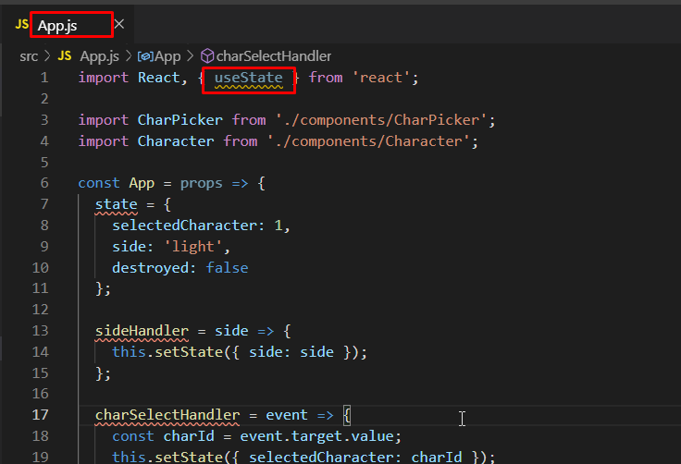
Instead of importing Component, start importing useState. Let us see how we can manage state with that.

Slide 23
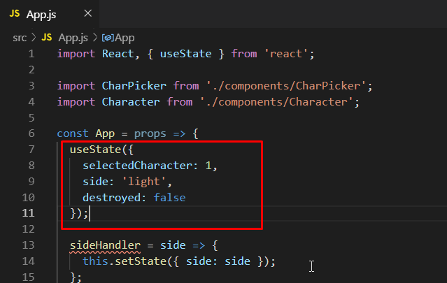
Write the useState method and add the initial state there. Now the question is, what does this do for us?

Slide 24
useState returns an array.
This is an array that always contains two elements.
The first element of that array that useState returns will always be your current state.

Slide 25
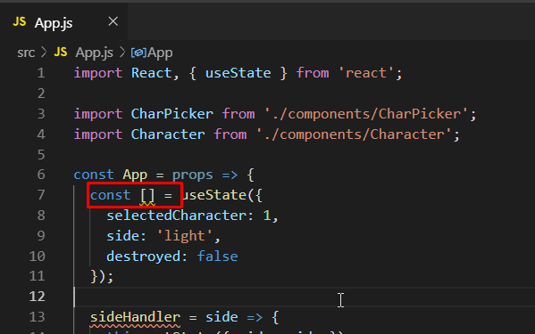
Here we can use array destructuring which is a modern JavaScript syntax where you [] on the left side of the = sign to pull out elements of that array and store them in separate variables/constants.

Slide 26
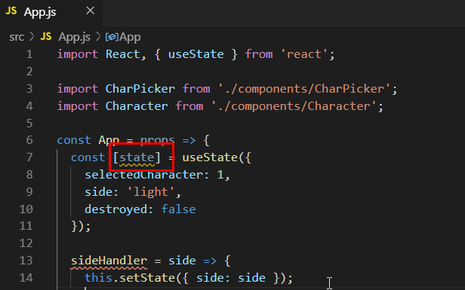
You can name these constants however you want. Right now we will name it state. We might change it later.

Slide 27
The first element, as mentioned earlier is the current state. Basically a snapshot of your state.
The second element has to be something that allows us to change that state.

Slide 28
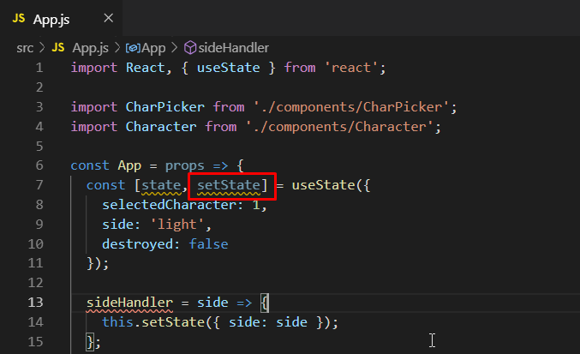
Hence the second element is a function that allows us to overwrite our current state. Here we have named it setState but you can name it whatever you want.

Slide 29
These two elements are always returned in an array by useState.
We can start using them similarly to how we used them before.

Slide 30
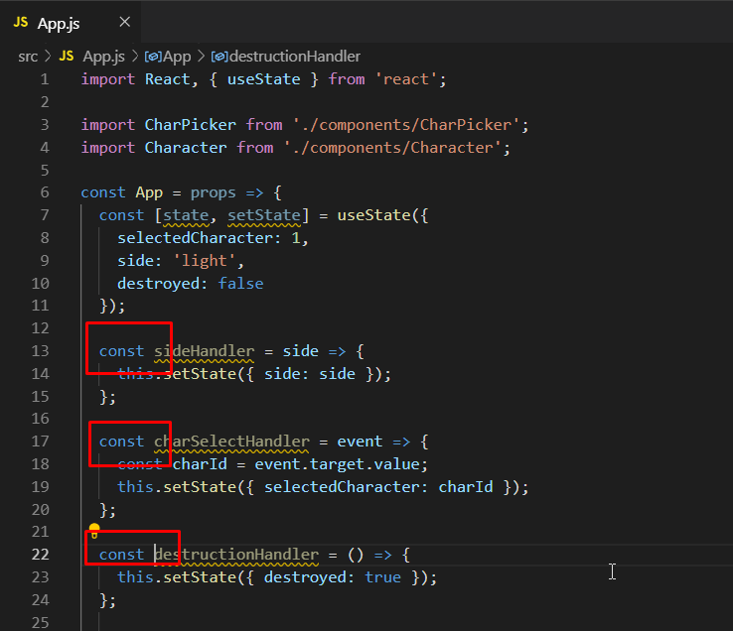
We had some methods in the App component before. But because of JavaScript, we can define functions inside of functions. All we have to do is turn them into constants that hold functions.

Slide 31
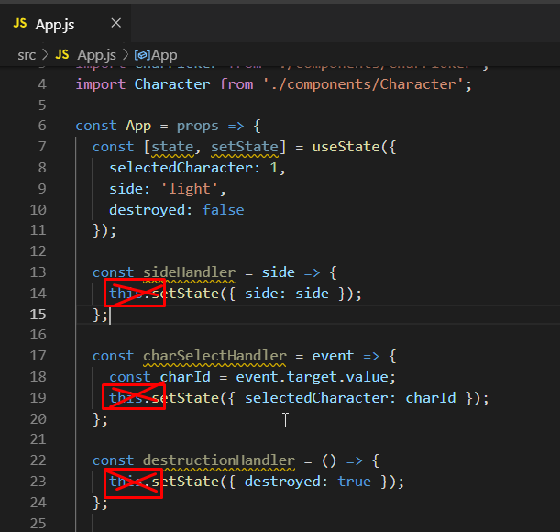
Now we have to adjust the code where we set the state. So to do that, since we are not in a class anymore, we need to remove the this keyword.

Slide 32
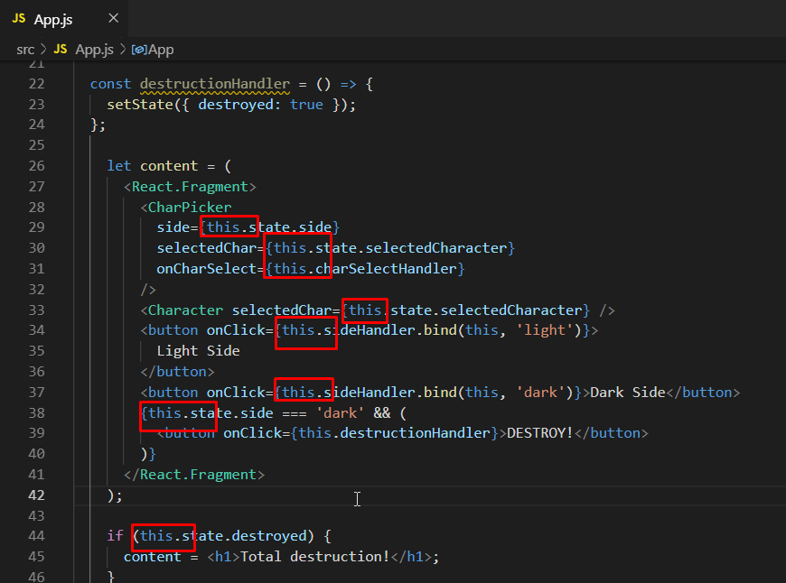
We need to remove this from these places as well now because of the changes that we made.

Slide 33
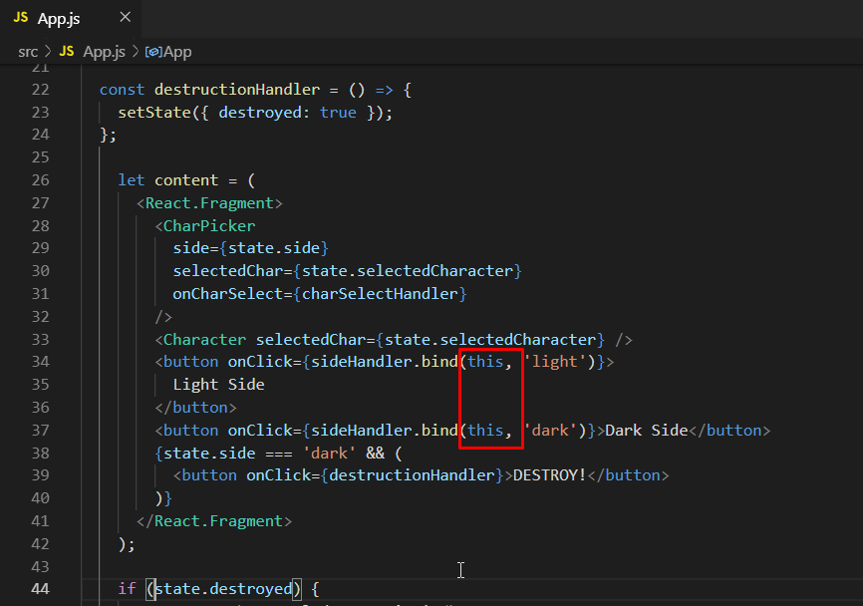
We are using bind here to tell JS that when the sideHandler function is getting called, then please pass in an argument light or dark. Hence, here ‘this’ needs to stay. However, it doesn’t matter if you pass this or even null as a this value. It really doesn’t matter at all.

Slide 34
Now we have almost successfully converted this component into a functional component using our first React hook.
But, there is a huge flaw here.

Slide 35
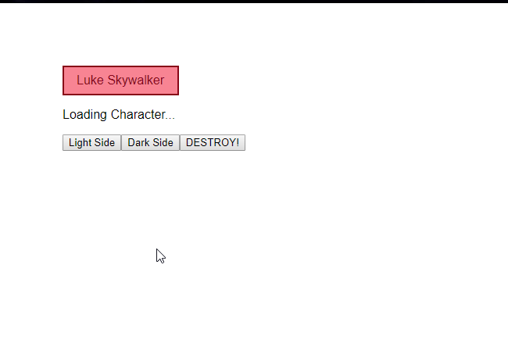
Now if we go to the output and click on the Dark Side, the application breaks.

Slide 36
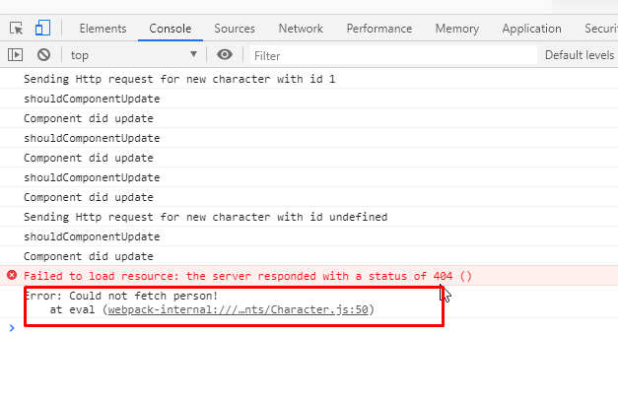
The developer tools console gives us this error.

Slide 37
There is a huge difference between the second element called setState that we are getting from the useState and how the state is actually managed there in general.
The state returned by useState is not merged with state updates passed to the function.
Instead when setState is called, you overwrite the entire state that was returned by useState call with the new object or value that is being passed.

Slide 38
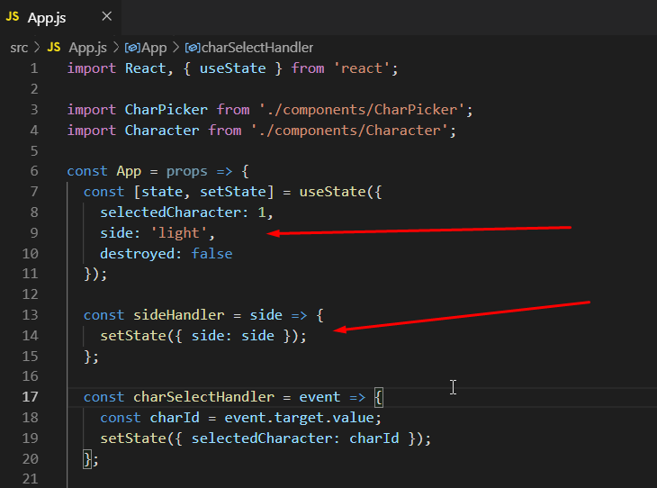
So where we have an initial state that looks like this, once sideHandler executes, we just will have a state object with a property and the destroyed and selectedCharacter properties are lost.

Slide 39
And because selectedCharacter is lost, we had got the error in the console.
So now, we need to merge this manually.

Slide 40
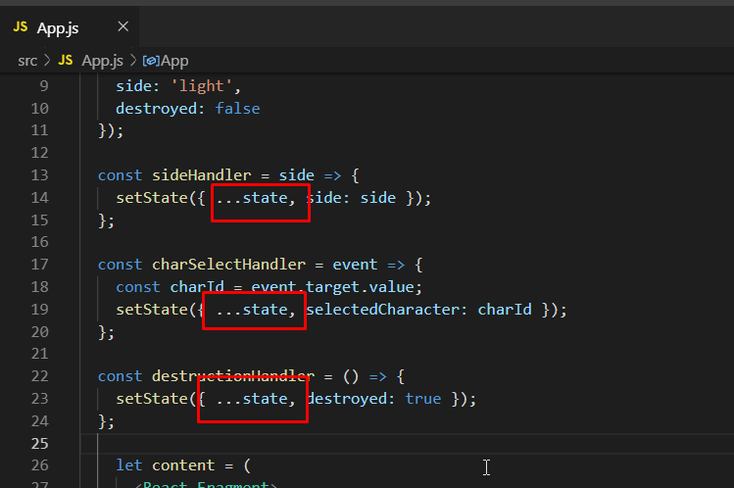
When we update our state, we can pass in an object but first we need to use the spread operator to get all the properties of our existing state and then we overwrite a part of it. Hence, everywhere we call setState, we manually merge it by doing this.

Slide 41
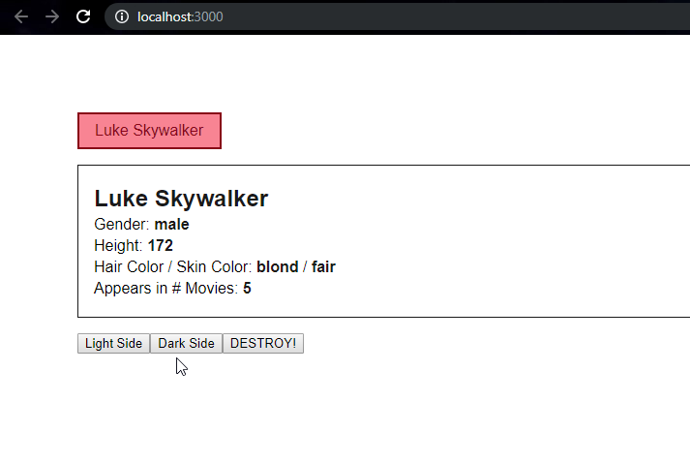
Now when you go and check the application, the dark side works perfectly fine.

Slide 42
This is good. But manually merging this is not a good idea.
There is a solution to this.
Unlike in class-based components, you are not limited to one state property and that is also the reason why with class-based components setState did merge the updates with your old state.
Now that is not the case anymore because you can simply define multiple states.

Slide 43
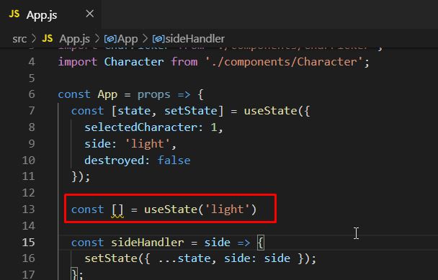
Create a new state. State doesn’t have to be an object. Here it is just a string, i.e. ‘light’. It could be a number, it could be array.

Slide 44
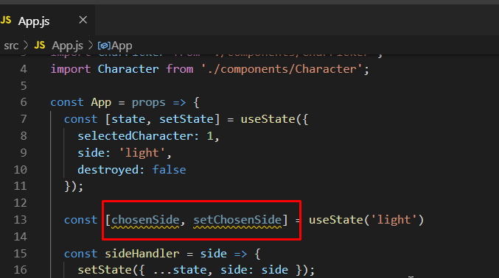
Add these as the two elements.

Slide 45
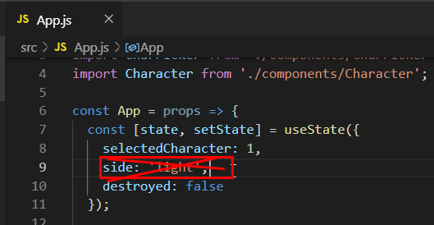
Remove side from the first state.

Slide 46
selectCharacter and destroyed would still be there.
These two things are not directly related and they are also not updated together.
So, we might want to split those into two different states as well.

Slide 47
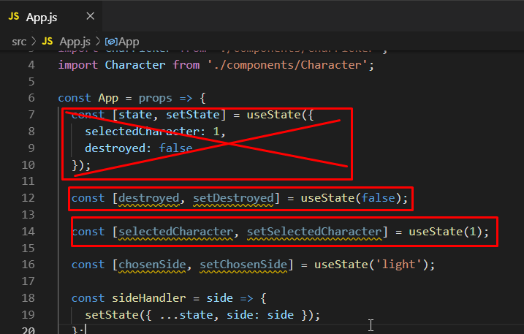
Add two new states and delete the first state.

Slide 48
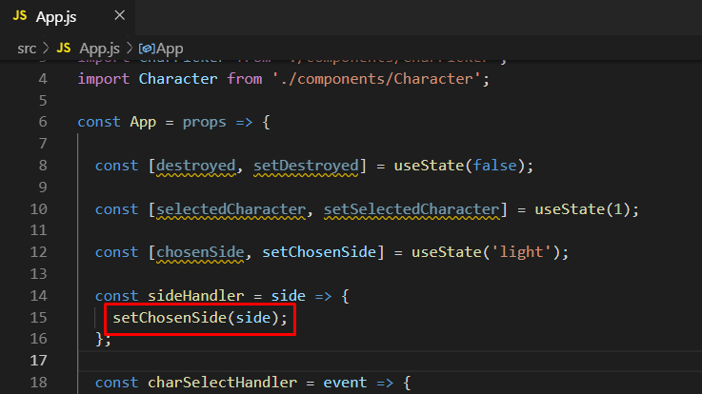
In the sideHandler, make this change. Now we just have to call setChosenSide and pass in side. Because that is a string and it expects a string as well.

Slide 49
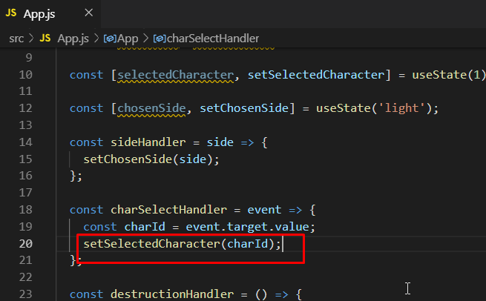
Similarly, make this change in the charSelectHandler.

Slide 50
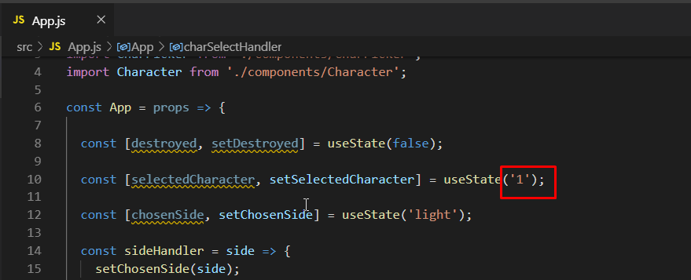
Down there it would be a string but here we initialized it with a number. This would totally be fine but just to be perfect, change this to a string.

Slide 51
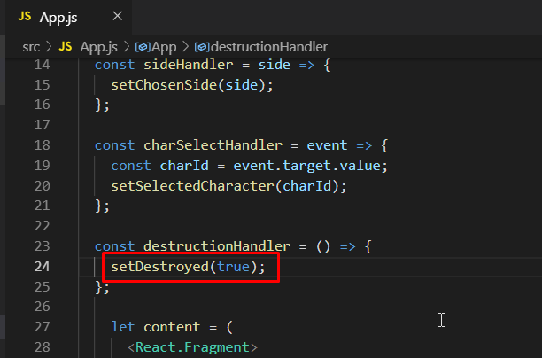
Similarly, make this change in the destructionHandler as well.

Slide 52
Of course, all the places where we have mentioned state won’t work anymore but now we have our separate constants.
We have chosenSide, selectedCharacter and destroyed states.
So, we have to use these constants now.

Slide 53
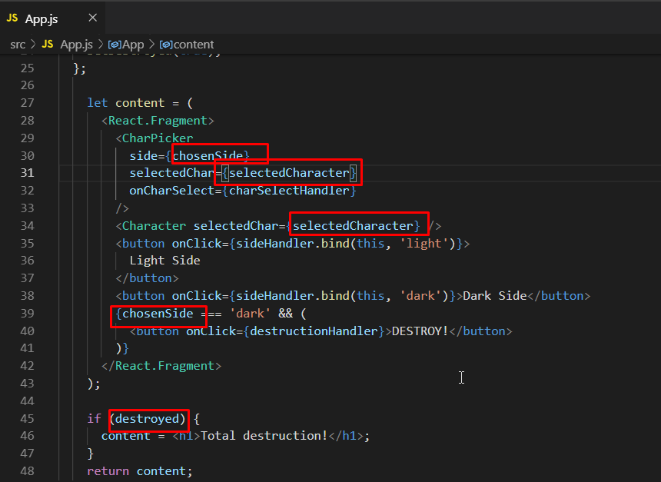
Make these changes in the code.

Slide 54
If you go to the application in browser, you will see that everything works perfectly and we don’t have to update manually.
It’s also a bit more readable and easier to understand.
That is our first transformation of the app component which now uses React hook called useState which is arguably the most important React hook.

Slide 55
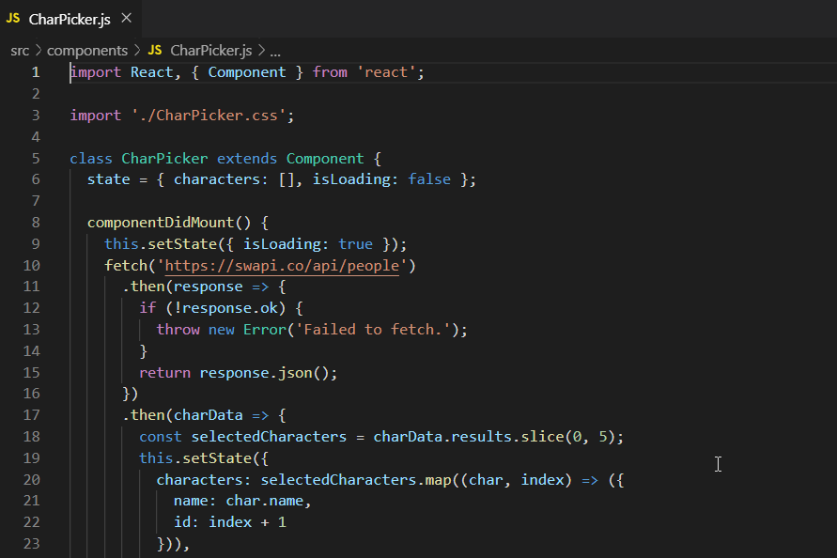
Now in the CharPicker component, we have the state and we know how to manage that. We also have a lifecycle method, componentDidMount. So, how do we work with that now in a functional component world?

Slide 56
You can’t add lifecycle methods like componetDidMount to functional components.
React hooks have a solution for that.

Slide 57
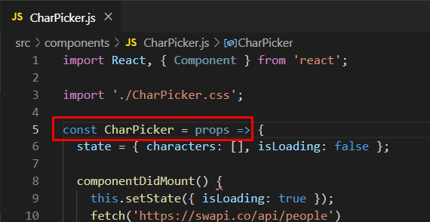
Change this into a functional component.

Slide 58
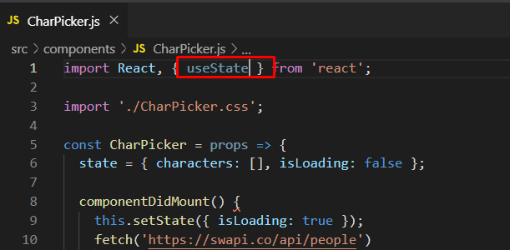
Import useState. Now instead of one state, we are going to use two states.

Slide 59
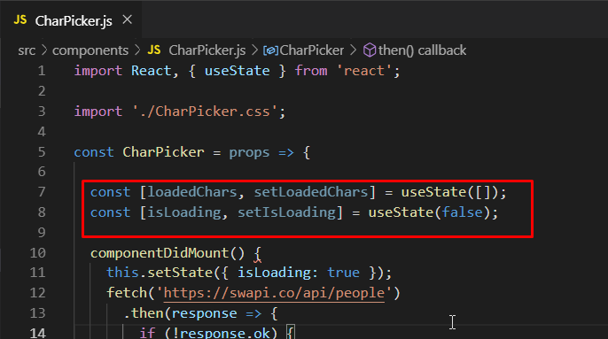
Replace the existing state with these two states.

Slide 60
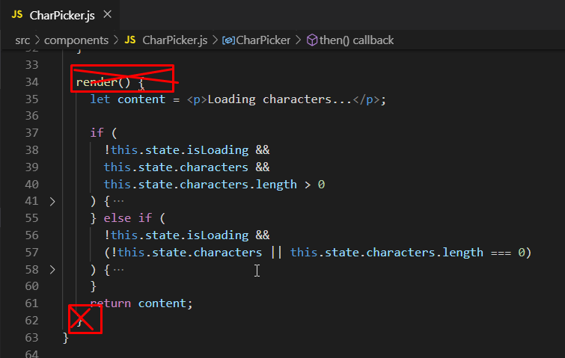
Now we need to fix our jsx code. Remove the render method first of all.

Slide 61
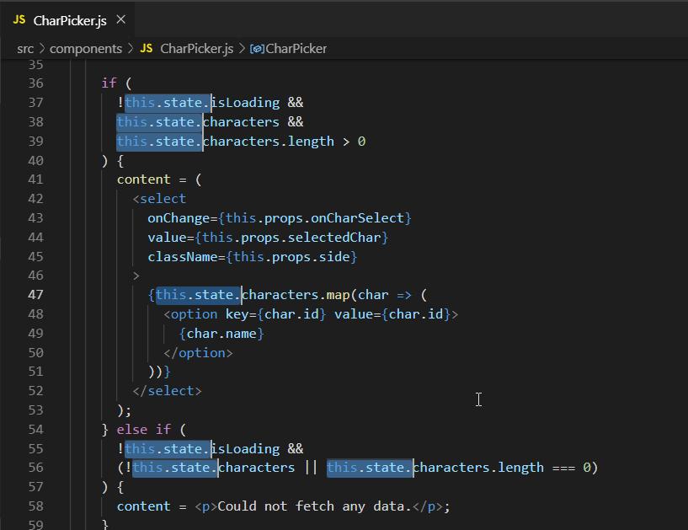
Remove this.state. From everywhere in the code.

Slide 62
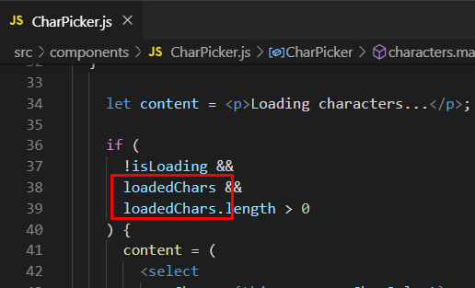
Replace characters with loadedChars.

Slide 63
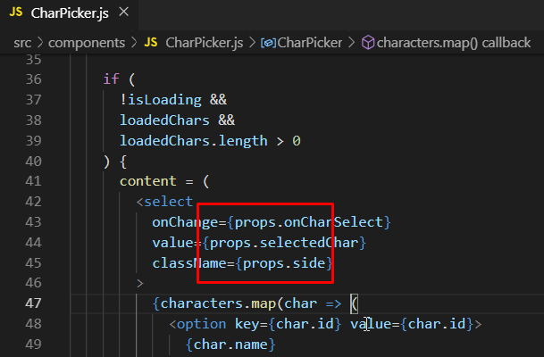
Instead of this.props, use just props.

Slide 64
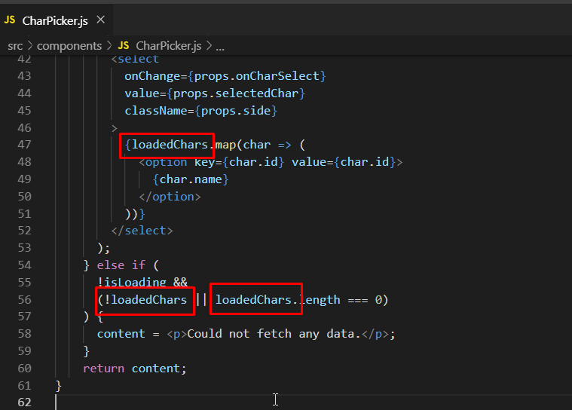
Then again replace characters with loadedChars.

Slide 65
We have replaced the state but what about componentDidMount?
useState is a super-important hook but it’s not the only one.
To manage componentDidMount, we can use useEffect now.
The reason why it is named useEffect and not useComponentDidMount is because useEffect is there to manage side effects like HTTP requests that happen in your components.
It works a bit differently than componentDidMount. Let’s see how.

Slide 66
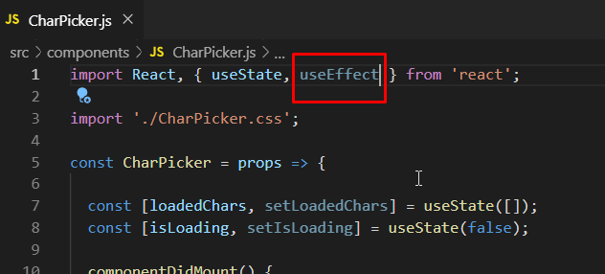
Import useEffect.

Slide 67
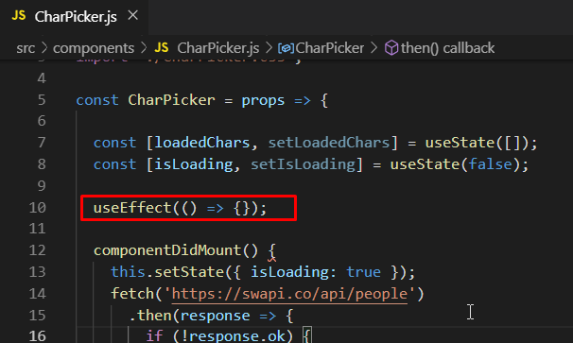
Add useEffect. It takes a function for an argument. This function will be executed for you by react on every render cycle after the component has been rendered. This somewhat sounds like componendDidMount because that also runs after the component.

Slide 68
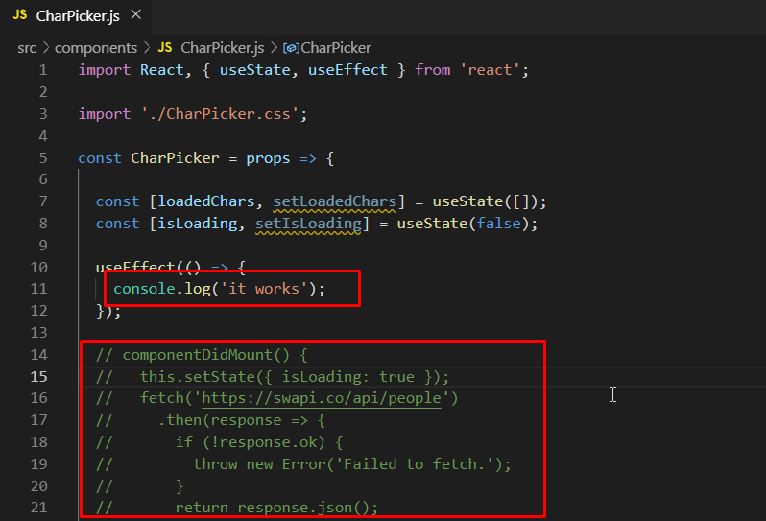
Add a console.log to the useEffect and comment out the whole componentDidMount code so that it doesn’t cause any error.

Slide 69
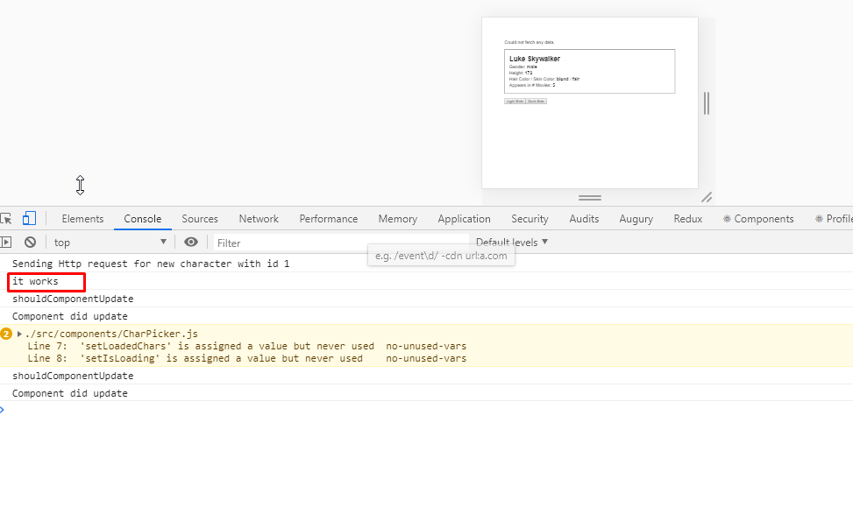
Go to the browser and dev tools and you will see that it works.

Slide 70
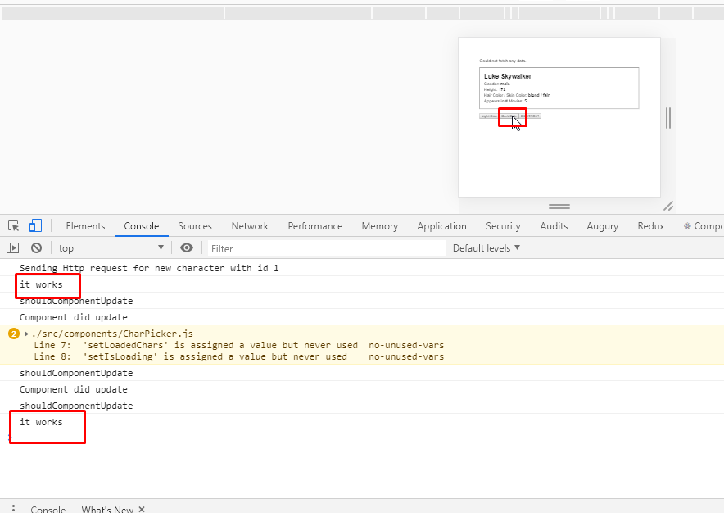
If you click the dark side button, you will see that it will display it works again.

Slide 71
So this means that since this runs in the CharPicker, then it runs more than once.
Remember that componentDidMount only executes once when the component mounts.
But the CharPicker was not remounted here. So, useEffect certainly works differently because it runs more often than componentDidMount.
That is on purpose, but you can control it.

Slide 72
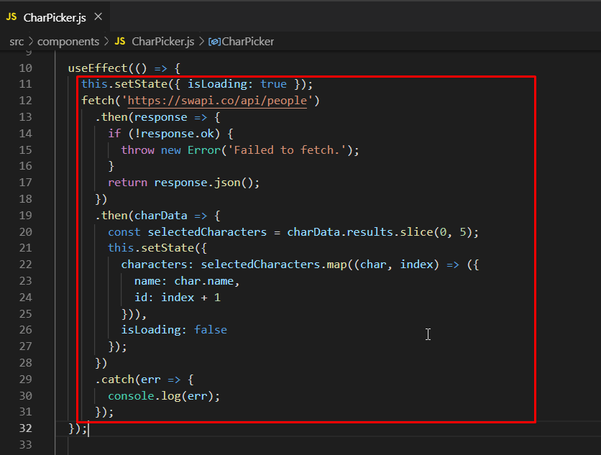
Before we control it, we need to move everything from componentDidMount to useEffect and delete componentDidMount. Also remove the console.log from useEffect.

Slide 73
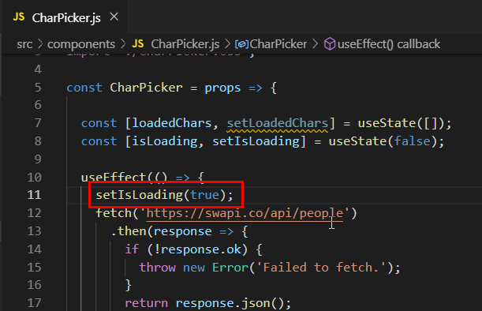
Replace the existing this.setState with setIsLoading(true).

Slide 74
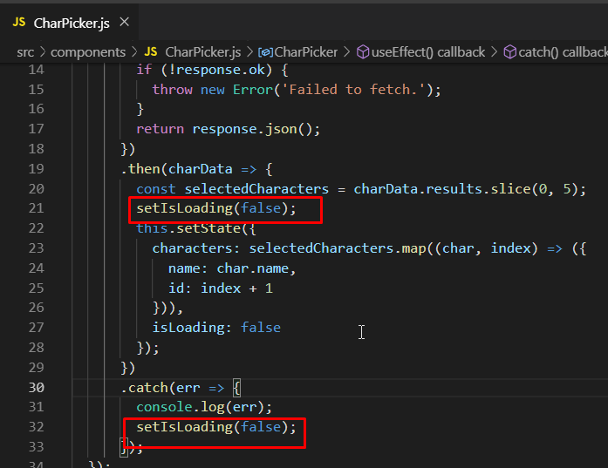
Then add setIsLoading(false) to these two places. First is when it has loaded and second is if we get an error.

Slide 75

Add setLoadedChars() and move the highlighted code to it.

Slide 76

Then, you can remove this highlighted code.

Slide 77
The code that we just moved to setLoadedChars essentially takes the data that we have in the response and transforms it a little bit to extract the data we need in the app which is the name and ID of the character.

Slide 78

In App.js, we made a mistake of turning the number into a string. It would still work fine but turn it back to number.

Slide 79
useEffect takes two argument. It does not only take the function as an argument which should execute after every render cycle.
It takes a second argument that is an array of dependencies of that function we passed to useEffect.
Basically an array where we have to state all variables that we use inside of that function we want to pass to useEffect.
So, anything that we pass to that array, if a pass a variable there then it means if that variable’s value changes, then the function you passed to useEffect should run again.

Slide 80

If you pass an empty array, then you’re basically saying ‘hey react, whenever this data I passed to you here which is an empty array, whenever that changes, please run that function I passed to you again.’

Slide 81
It will always run for the first time but the subsequent executions are blocked because if we pass an empty array, there is no data that could change. Therefore data never changes and react never executes.
IMPORTANT: So, useEffect with an empty array as the second argument is equivalent to componentDidMount.

Slide 82

Check the application and it would run perfectly fine.

Slide 83

To check how it just runs for once, put a console log here.

Slide 84

Go to the dev tools and refresh. Make changes in the browser and you will see that it runs for just once.

Slide 85
Try at home
Try removing the empty array that we provided as the second argument.
What will happen?
The useEffect will go in an infinite loop.

Slide 86
Here the default is that useEffect would run on every update of the component but we can control when it should update by passing an array of dependencies.
And if that array is empty, then there are no dependencies that could change and therefore it will never run again.
With that, we have converted the CharPicker component to a function component as well.

Slide 87

Remove the console log that we added.

Slide 88
useEffect can run more often if you need it.
We will see that in the character component now.

Slide 89

Character.js is also a component that we have created with class keyword and we can easily convert this into a functional component.

Slide 90

Convert the class into a functional component. Import useState and useEffect. Comment out the shouldComponentUpdate code for now.

Slide 91

Add two new useState calls and remove the old state object.

Slide 92

Get rid of render() and it’s closing curly brace.

Slide 93

Select all the instances of this.state. and remove them. Our JSX would work. But we still have errors in code.

Slide 94

Comment out componentWillUnmount for now.

Slide 95

Convert fetchData into constant that holds a function.

Slide 96

To handle componentDidMount, add useEffect with the two arguments.

Slide 97

Call fetchData there. Notice how don’t call this.fetchData() because we are in a functional component now. Also remove componentDidMount.

Slide 98

Move fetchData above the life cycle hooks so that we define first before calling it. This is not strictly necessary but it is a good practice.

Slide 99

Comment out componentDidUpdate as well and see if it works.

Slide 100

The browser gives us this error.

Slide 101

Replace all the instances of this.props with just props.

Slide 102

Now it will give us the problem with setState.

Slide 103

Add setIsLoading at two places and set it to false. Also add setLoadedCharacter and set it loadedCharacter. Now we don’t need the setState so remove that.

Slide 104

Up in the code set setIsLoading to true and remove the setState from there as well.

Slide 105

Now we won’t get an error.

Slide 106

But if you change the character, nothing will happen.

Slide 107
That is because the componentDidUpdate is commented out.
That previously was responsible for waiting for updates to the component and if the update was caused because our selected character was changed, then it fetched data again.
componentDidUpdate doesn’t exist here now.
But we have useEffect and we can use that to replace componentDidUpdate as well.
Remember that useEffect generally runs after every render cycle.
And we can restrict that by adding a second argument which is an array of dependencies and it specify no dependencies, it runs just once. But here, we want useEffect to run more than once.

Slide 108

Create another useEffect with props.selectedChar in the array of the second argument. That is our dependency here. Whenever that data changes here, we want to re-execute that. We are reffering to the value that’s stored in selectedChar in our selectedChar prop and when that changes, it will re-run.

Slide 109
In reality, what we have done with two useEffect would be a bad code.
Because in reality both effects run when the component is rendered for the first time. So we send at least one redundant HTTP request we have also have the same logic in there.

Slide 110

So to overcome that, we can just comment out the first useEffect.

Slide 111

So now we can say that we have the logic in useEffect that we had in componentDidUpdate in a way simpler form.

Slide 112
Go and check the app. It would be running perfectly.

Slide 113

Now about componentWillUnmount. Right we are just doing a console.log there but in real time applications, you might have something important there.

Slide 114
Now there is one more feature of useEffect.
Right now we are executing something that runs after every render.
What else you can do with that is useEffect can either return nothing (which it is doing right now) or you can return another function.

Slide 115

So, return an arrow function. Now the code in this arrow function will execute right before useEffect will run the next time. It is a clean-up function that basically runs once useEffect is done before it runs again.

Slide 116

Add this console.log in the arrow function.

Slide 117

Now when you first the run application, use effect would run but cleaning up won’t happen. Because this is the first run.

Slide 118


If you change the character, cleaning up happens because useEffect runs again because the component renders again.

Slide 119

And if you switch to dark mode and destroy a character, then also cleaning up runs because then the component is rendering again and hence useEffect is also running again.

Slide 120

Add one more useEffect like this. Now what this will do is that since there is no change in the component happening like fetchData, this will run only when the component is cleaned up, which is, when the character is destroyed.

Slide 121

So now clean up will happen if you change the character but component did unmount will not happen.

Slide 122

But if you destroy a character, cleaning up and component did unmount both will happen. This might look a little bit complex but it is pretty straightforward if you understand it well.

Slide 123

Now above shouldComponentUpdate. Add this console log to the component code.

Slide 124

So you would see rendering for each time something loaded.

Slide 125


And then it will render if you switch from light to dark and it will render again if you switch from dark light.

Slide 126

It will render for every subsequent time you change sides on the same character. But this should not happen because we are not loading anything new. We are just changing the sides.

Slide 127
To avoid these re-renders, we were earlier using componentShouldUpdate.
But in a functional component, you cannot use that.
What you can do however is, you can wrap your entire component when you export it with something called React.memo.

Slide 128

Like this. Memo is a method that was introduced with React 16.6 and it memo-izes this component. It means that it basically stores it and only when inputs to this component (the props) change, then it will re-render this.

Slide 129


Now when you change the sides, it won’t re-render anymore.

Slide 130
Because now react detects that the side is not a prop used in the component at all.
However, if you change a character, then it will re-render because then you have changed something in the component.
So, react memo is basically shouldComponentUpdate and it automatically knows what to watch for.

Slide 131
Custom Hooks
Along with allowing you to create every component as a function component using pre-defined hooks, React also allows you to create custom hooks.
By doing that, we can share (possibly stateful) logic between components easier than before.

Slide 132

In Character.js and CharPicker.js, we are making HTTP request. We can share this by making custom requests.

Slide 133

Inside src folder, create hooks folder and inside that, create http.js.

Slide 134

Add this code to start creating your custom hook. The word use should be used so that it would be clear that we are using a hook.

Slide 135


Go to CharPicker.js, cut the highlighted code and paste it in http.js.

Slide 136

Then since we need to manage state here, import useState and create an initial state.

Slide 137

Then we have the setLoadedChars as well.

Slide 138

To manage that, create one more state which would be not just for the characters but for fetched data in general. We are doing this because we want to make this reusable.

Slide 139

Comment out this block of code since we don’t want to fetch data like this.

Slide 140

Change charData to just data. And then setIsLoading to false and setFetchedData to data. So, we are setting it to the data that we got back.

Slide 141

The URL is also not always the same. We probably get this as an input to this hook. So, when you create your own hooks, just as the built-in hooks, you can receive the arguments.

Slide 142

Add an argument to useHttp called url and pass it in fetch below. You can copy an instance of the fetch with the actual url and comment it out for reference.

Slide 143
However, it is not that useful if we managed a loading state and the data in the function here.
We need that in our component where we are actually going to use the custom hook.
It is important to remember that hooks, both predefined and custom, can return anything. Be it string, number, array, etc. It can also return nothing, which exactly useEffect does.

Slide 144

So, add this. Now we have a hook that returns information about whatever we’re loading and which data it has fetched. Let us now use this hook.

Slide 145

In CharPicker.js, import useHttp. Now we can use our custom hook here.

Slide 146

Remove setIsLoading(true) from useEffect.

Slide 147
Some important rules for hook
You always must call hooks (no matter if they’re built-in or custom), on the top level of the functional component.
You cannot call it nested in another function call nor you can call it nested in an if statement or a for statement.

Slide 148

That means that you cannot call it like this which is inside another function call.

Slide 149

You have to call it like this. Of course the downside of this is that it executes whenever the component gets re-rendered.

Slide 150
But the good thing is that, we can use useEffect in our hook.
So you can use other hook inside the definition of your own hook just as we use useState.
But using a hook inside useEffect is not allowed because you’re not running useHttp in useEffect. You are actually running in an argument you pass to useEffect.
So you have to understand the difference.

Slide 151

Back in http.js, import useEffect and use it. For its second argument, we are going to use dependencies. So we need to pass that as well.

Slide 152

Now move the highlighted fetch code inside useEffect. Not the return statement. Just the fetch code.

Slide 153

And then setIsLoading to true.

Slide 154

Also add a console.log to check if we are sending a redundant Http request.

Slide 155

Now we have the same logic as before but just outsourced into our custom hook. And hence in the CharPicker, we can get ride of the useEffect.

Slide 156

And then in useHttp, pass the url as the first argument and an empty array as dependencies in the second argument.

Slide 157

Since we don’t need to manage state for loadedChars and isLoading here anymore, you can remove the highlighted code.

Slide 158

Use array destructuring to do this. We have already done this before with the built-in hooks.

Slide 159

Go to http.js and cut the highlighted code where we are define the details about characters.

Slide 160

Paste and uncomment it in CharPicker.js.

Slide 161

Instead of charData, use fetchedData.

Slide 162

Remove setIsLoading and setLoadedChars because now we can map selectedCharacters directly.

Slide 163

But then you can map the adjusted characters to the selected characters itself. So, selectedCharacters will now be an array of objects where each character has a name and an ID.

Slide 164


And now everywhere where we are using loadedChars, we need to use selectedCharacters because that is now our property that gets the adjusted data that is returned by our custom hook.

Slide 165

But we are still getting an error here.

Slide 166

The problem is that our own hook initializes the data with null as a value and that is the first value that it returns.

Slide 167

We can check if fetchedData is true and then execute the code otherwise set it to an empty array. That is all we need to do here.

Slide 168

The application would work perfectly fine. It would send an http request from http.js for the first time but when you change the character, it won’t send another request. Hence, no redundant requests are being sent from http.js.

Slide 169
So now we can reuse our custom hook logic in the Character.js file as well.

Slide 170

Go to Character.js and first of all get rid of the highlighted code.

Slide 171

Import useHttp and start using it. For the first argument URL, pass this URL which also has props.selectedChar.

Slide 172

For the second argument, we are going to pass the array of dependencies which would be this that we were already using in useEffect.

Slide 173

So, pass that as the second argument.

Slide 174

Since we are getting something back, we need to do this just like we did before. And then just like we did some transformation of the data in CharPicker, we will do that here.

Slide 175

Cut the highlighted code.

Slide 176

Paste it here.

Slide 177

Get rid of the entire fetchData code.

Slide 178

Get ride of this commented out code along with the useEffect hook where we are cleaning up.

Slide 179

Set loadedCharacter to be null and say if we have fetchedData then set it to loadedCharacter. Remove the const from there.

Slide 180


Replace all the instances of charData with fetchedData.

Slide 181

Down in the if else if statement, remove .id from the loadedCharacter. Now we will just be checking if it there are loadedCharacters or not.

Slide 182

Get ride of useState import and its implementations.

Slide 183

And in CharPicker.js, you can stop importing useState and useEffect since we are not using them there anymore.

Slide 184

Go to browser and dev tools and you will see that it sends two Http requests. One for all our characters and one for the person that should be loaded.

Slide 185

To make it more clear, you can add this to the http.js.

Slide 186

Now when you go to dev tool, you will see urls. One is to fetch all the people and the other is to fetch the person with ID 1.

Slide 187

If you switch a character, you will see that it just sends one http request to fetch the person with that specific ID.

Slide 188
It can be confusing to see this and it is a brand new way of thinking about component creation.
Important: You don’t have to switch! React Hooks work alongside class-based components and class-based components are not removed React.
Custom hooks help you to save code and centralize stateful logic and then share it between the components that need it.

